Slide 1
03 | Page Layout
Helen Zeng | Developer Evangelist
Christopher Harrison | Content Developer

Slide 2
Module Overview
Positioning elements
Margins & Padding
Interacting elements

Slide 3
Positioning Elements

Slide 4
The display property
Determines if and how an element shows up on the page
Block – needs a new row for itself
Inline – used for elements that are displayed in-line, such as a link or perhaps a small picture
None – hides an element

Slide 5
The position property
Static (default)
Relative – relative to where its default position
Fixed – relative to the browser window
Absolute – relative to its first positioned parent element

Slide 6
The CSS Box Model

Slide 7
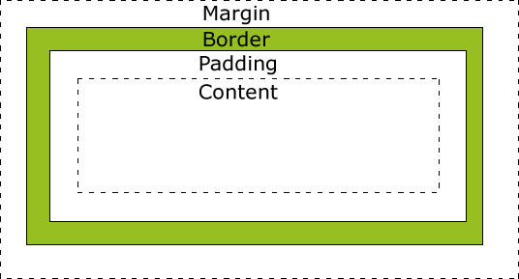
Basic element selection
Margin – space around an element
Border – visible border around element
Padding – space within an element
Box Sizing

Slide 8
Elements interacting

Slide 9
The float property
Doesn’t apply to absolute positioned elements
Allows other elements to flow around
Allows elements to be positioned on the same row
Use clear to reset

Slide 10
Element conflicts

